Slide 1
Spill Response Kit
Training
Notes:
A recent incident highlighted the requirement for PPE and materials to deal with spills.
These kits can provide medium spill containment of Oil ,Gas , Diesel and Acid , as well as neutralization for Acids.
This reduces primary concerns of fire, acid burns and slip and fall hazards.
The use of Personal Protective Equipment provided , in conjunction with the neutralizer , and absorbents will allow safe remediation of small and medium spills.

Slide 2
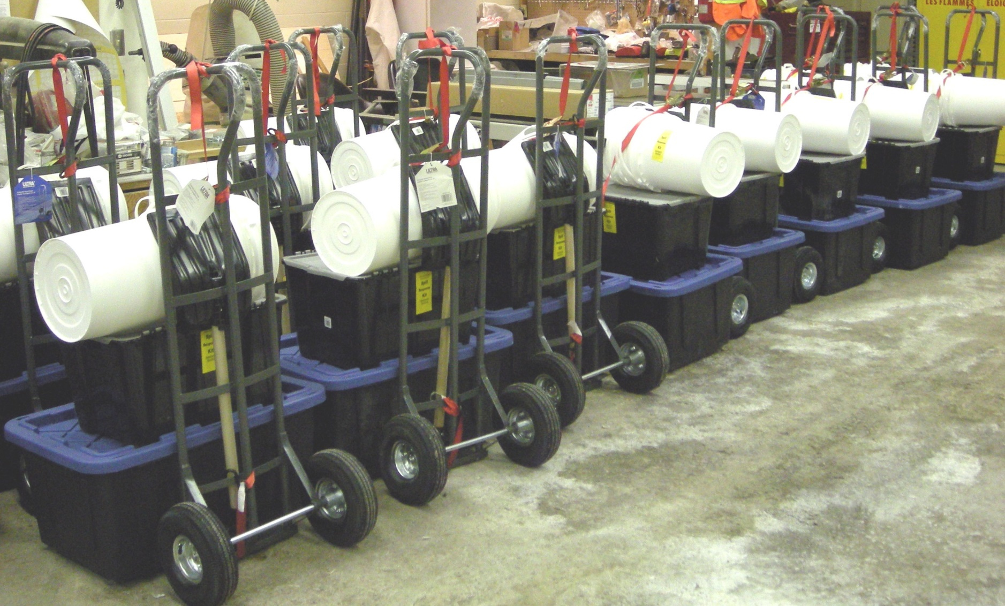
Spill Kits

Slide 3
Spill Response Kit Contents
Notes:
Contents checklist is provided in the MSDS Files in the tote , as well as instructions for use for Acid Neutralizer.

Slide 4
Contents List
Oil Gas and Acid - Spill Response Kit
Updated 01/12/22 CONTENTS CHECKLIST
Item Description Quantity Part Number (Grainger)
Gauntlet Gloves I pair JNCBC114
Urethane Apron ANLYU48
Boot Cover 1 pair DUCPE444SWHXL010000
Hand Cleaner 2kg GOI0915-06 (lemon scent)
20 litre plastic pail 3 GNP 746
Optisorb (AbZorball) 10kg FLD25
Peat Moss Loose 40 litre BIG PSL2
Universal Pad (Oil) 20 CDRALL1519L100
Acid Neutralizer
(Sodium carbonate powder) 2 – 1 kg BIGNRDANO3
Coloured bags 27 RSN2981-05
Mono Splash Goggle 1 pair WSSA610S
Face Sheild Harness and
Visor 1 FBRF300
12” handle scrub brush 1
1 litre plastic scoop 1
1 m D handle plastic shovel 1
SPILL RESPONSE KIT
Accompanying the kit are the SDS Sheets in a plastic file folder
Instructions for use are in folder
A 2 wheeled hand truck with 3 pails (no lids)
Shovel
2 -plastic totes
- 1 for Absorbents
-1 for all other items
Items should be strapped to cart for transport readiness

Slide 5
A spill is discovered!
Once a spill is found or reported , evaluate the situation for hazards.
Can you identify what is spilled?
Oil ,Gasoline , Diesel or Acid.
Evacuate people from the area for their protection in the event of a gas or acid spill.
The spill kit can handle a medium spill of oil or diesel with the dyke absorbent and absorbent peat. Additional amounts with the universal absorbent pads.
Gasoline spills must be contained and covered with peat as soon as possible to prevent vapor production and the possibility of fire.
A leaking or spilled battery can produce minor to medium amounts , from powered scrubbing units or wet cell batteries in storage.
The motive power battery acid will be dilute Sulfuric Acid usually no greater concentration than 10-15% by weight.

Slide 6
Use the PPE Provided
Only approach spills when you are wearing the required PPE.
Protective boots will prevent damage to footwear and pant legs.
Aprons protect your body from splashing.
Your face and eyes must be protected from liquids and absorbents. Wear the Splash goggles, and face shield together.
Wear the Gauntlet gloves to protect your hands and forearms.
Use caution as PPE can trip you or present slip hazards around spills and absorbents.
Never attempt to step or jump over a spill.
Walk around the perimeter .

Slide 7
Containing a spill.
Each scenario will differ, from inside to outside the building.
Use the granular absorbents to dyke off the area to prevent spreading. Apply a ring around the spill using the provided 1 liter scoop.
Oil ,Gas or Diesel spills are to be covered and mixed into the peat moss . Use the scoop to spread it , the shovel to mix it.
Continue adding absorbents until the spill firms up solidifying or can be handled without being fluid and running.

Slide 8
OIL,GAS OR DIESEL SPILLS
Place yellow bags into the provided collection pails ,, double bags to prevent failure. Place the appropriate Waste Indicator label on the bag.
Never completely fill a bag.
Secure the tops but do not tie them off tightly.
This will allow vapor pressure to escape if there is any without compromising the bags.
If the spill is indoors ,apply the provided Hand Cleanser to the remnant materials and scrub with the brush without the use of water.
Collect with paper towels or absorbent matting to dispose of slurry.
Store the waste outdoors in a safe area for pickup.

Slide 9
ACID SPILLS SULPHURIC BATTERY ACID
Make sure to wear your PPE before attempting a Acid spill Neutralization.
Battery Acid Spills from leaks due to overcharging , rupture or upset must be contained using the products to form a dyke around the area with the granular absorbent.
Apply the Acid Neutralizer around the perimeter of the spill and continue adding until the neutralizer remains pink. This indicates neutralization has taken place.
Vigorous bubbling and minor splashing may occur while this takes place . Heat and fumes may be generated as well , which is normal.
Once you apply the Neutralizer leave the area to prevent exposure to any fumes . Normal ventilation should adequately disperse the fume to safe levels within 10-15 minutes.

Slide 10
SPILL CLEAN UP
Double bag pails and apply the appropriate label.
Scoop the pink Neutralized materials into the bags.
Do not overload bags. are to be loosely secured.
Use soap and water to do a finish wash on the spill area after Neutralization has been completed.

Slide 11
Maintain the Kit
Always inspect the kit to make sure all components are accounted for in correct quantities.
Once used , replacement materials can be provided using the supplied Gainger part numbers.
Contact the Health and Safety Coordinator for replacement materials.
Do not clean or return PPE items to the storage totes , dispose of heavily contaminated items and order replacements

