Slide 1

New and Current Worker
Health & Safety
A primer

Slide 2
Learn who your Health & Safety Rep is at your worksite.
Ask to see the Health & Safety Bulletin Board at your location.
All your relevant Health and Safety information for the Board and Workplace are posted here.
Your Health & Safety Reps are trained persons who can guide you in your inquiries and concerns and assist in directing your concerns to the appropriate people.
Be sure you complete the training on Worker Health & Safety in Four Steps at the link below , or 5 Steps for Heads and Chiefs and TICs
Worker health and safety awareness in four steps | ontario.ca
Supervisor health and safety awareness in five steps | ontario.ca

Slide 3
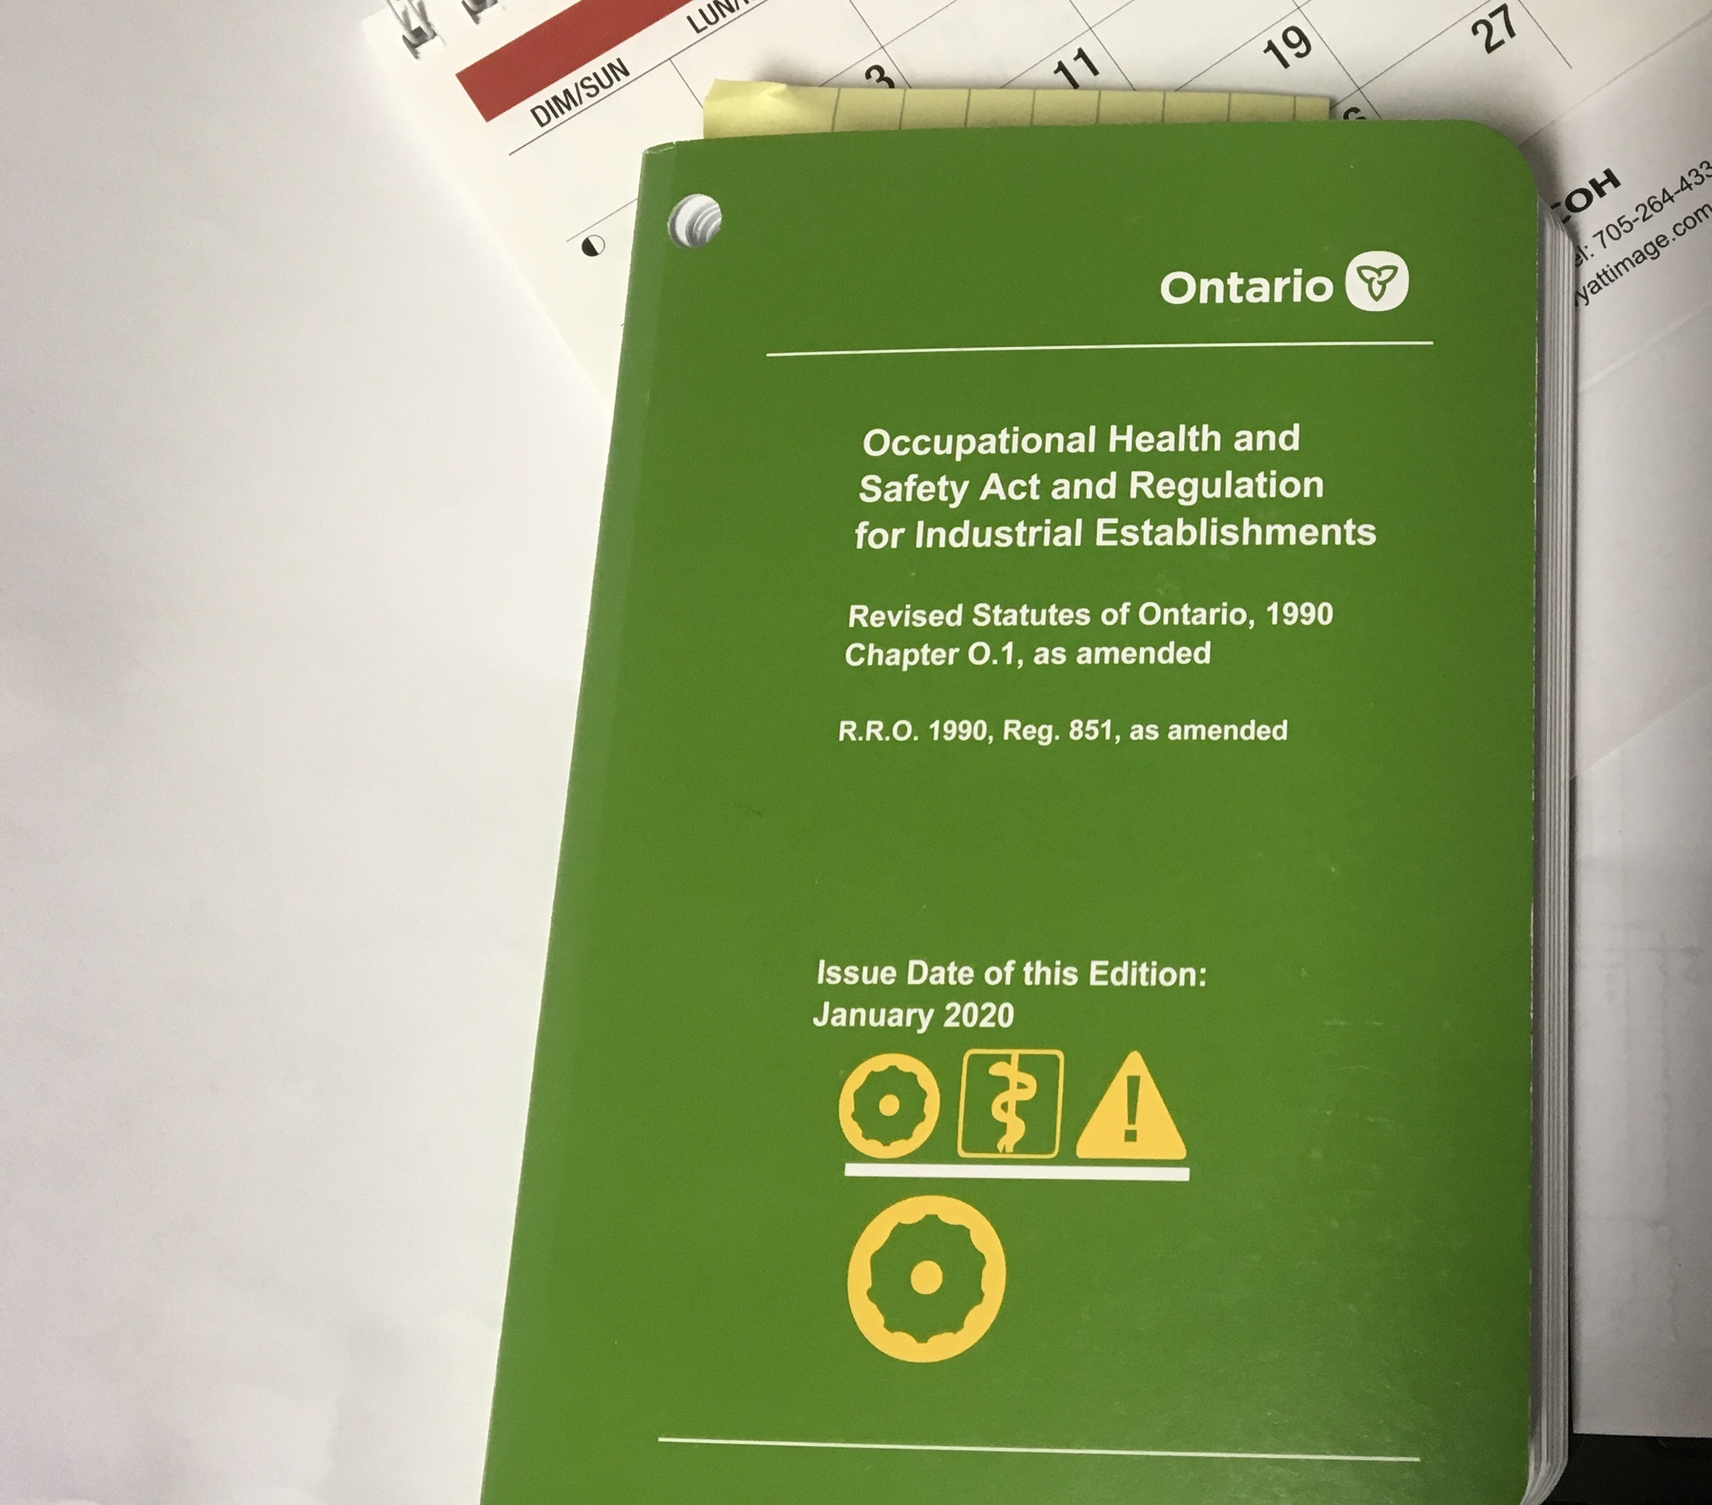
School properties are regulated under regulations for Industrial Establishments
The source of directives are from these regulations and codes.
Also included are the other Regulations referenced within the Act and Regulations such as , Building Codes , Fire Codes. , Gas Code Electrical Code , etc., CSA Standards etc..

Slide 4
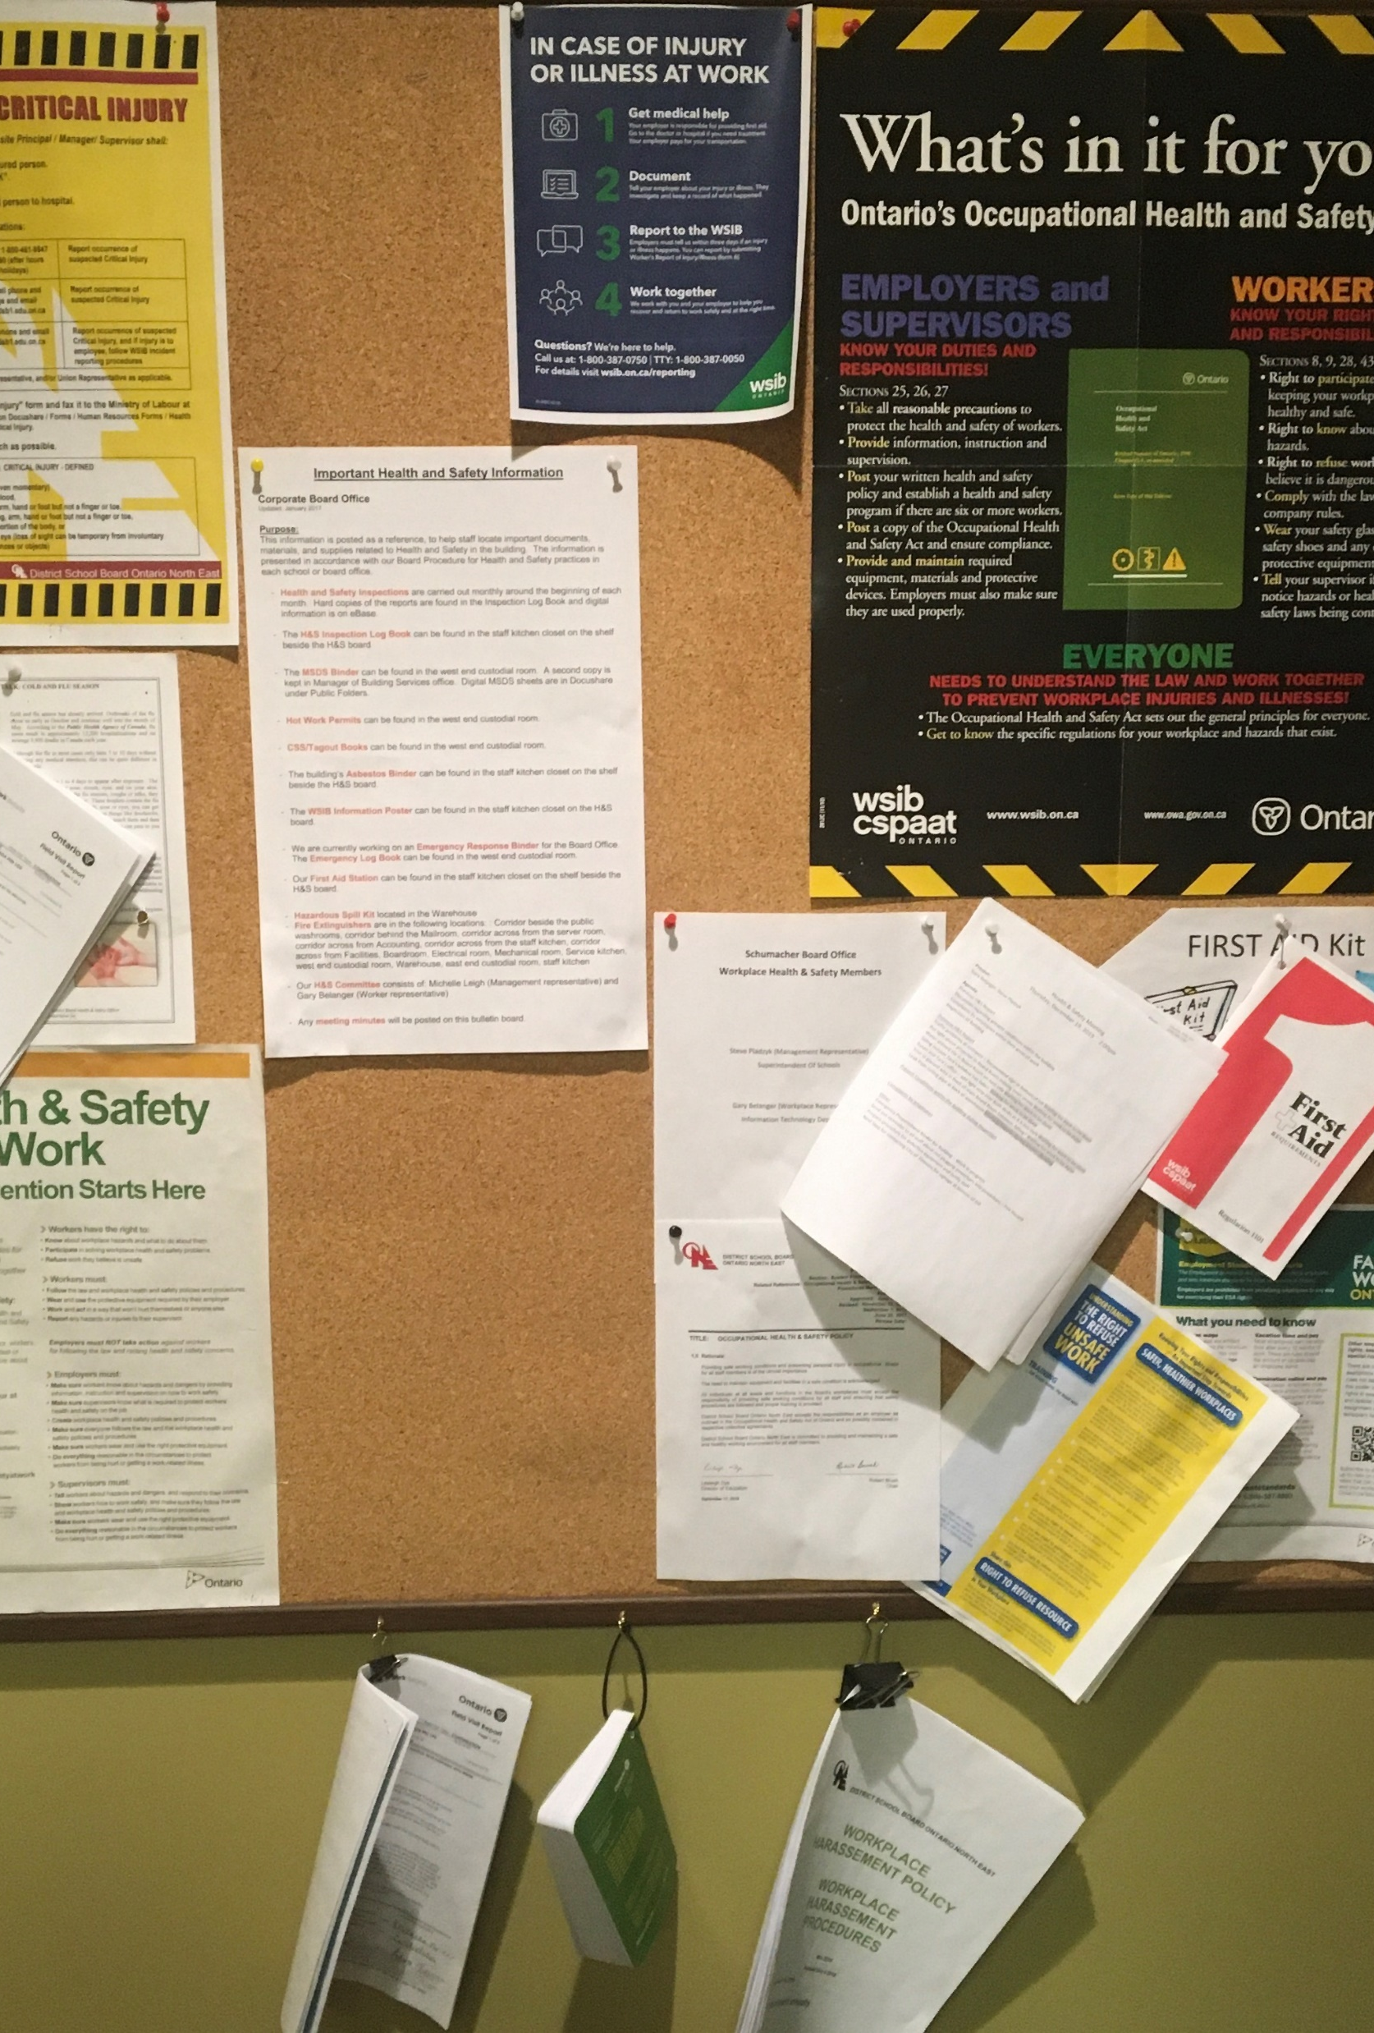
Health & Safety Bulletin Boards
Your information center
at your workplace

Slide 5
WHATS ON THIS BOARD
** POSTINGS REQUIRED IN THE WORKPLACE **
- A recent copy of the Occupational Health and Safety Act
- Health & Safety at Work: Prevention Starts Here
- In Case of Injury Poster (“1,2,3,4”) -
Health and Safety Policy (Copy of Board Policy )
- Workplace Harassment Policy (Copy of Board Policy )
- Workplace Violence Policy (Copy of Board Policy )
- Names and work locations of Joint Health and Safety Committee Representatives
Schedule of Inspection Dates
Names of Certified First Aid Trained Persons and locations
Copies of completed Inspection Reports

Slide 6
An important section of the Act is Part V
Right to Refuse or to Stop Work
Where Health and Safety in Danger
Part V: Right to refuse or to stop work where health and safety in danger | Guide to the Occupational Health and Safety Act | ontario.ca
the right to know
the right to participate, and
the right to refuse unsafe work

Slide 7
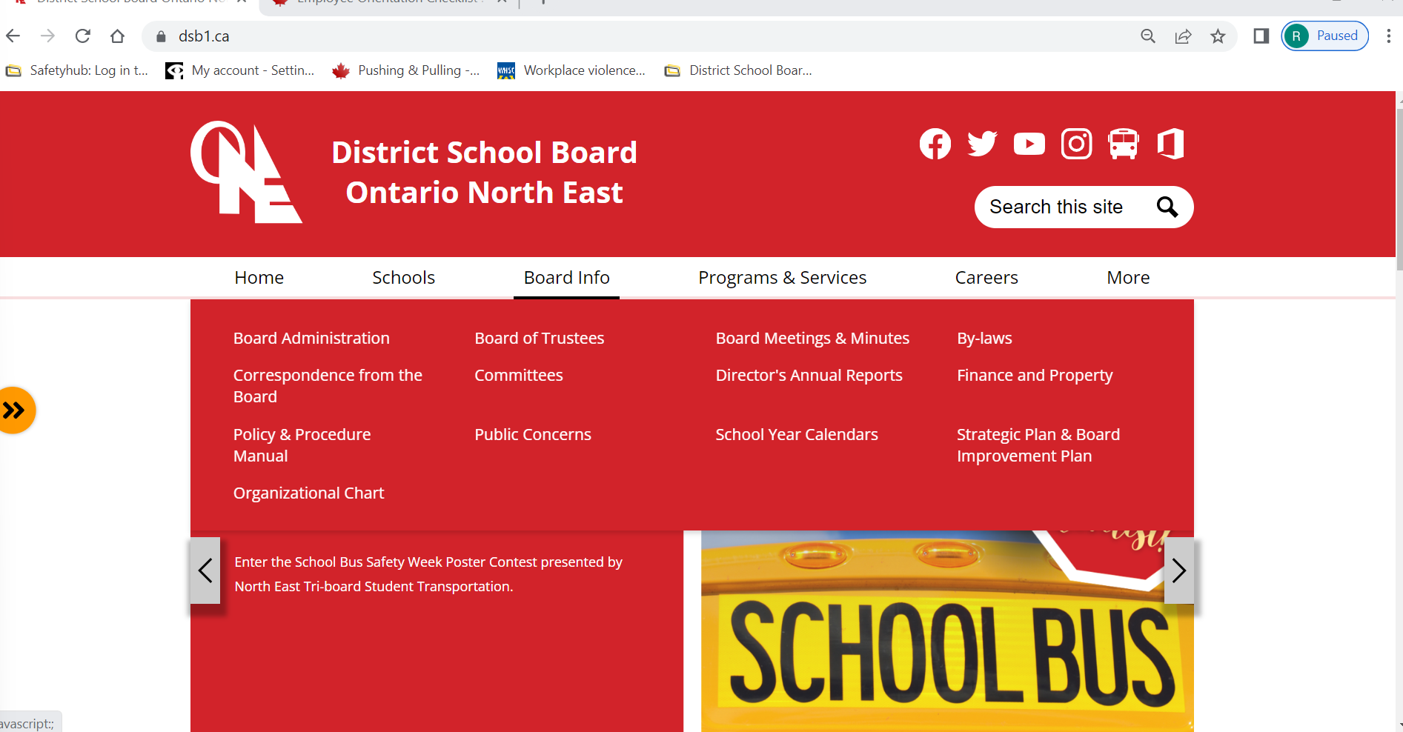
Part III.0.I Violence and Harassment all a part of the District School Board Ontario North East Policy
Policies and Programs are posted for your viewing
These are found easily on the Boards Web Page

