Slide 1
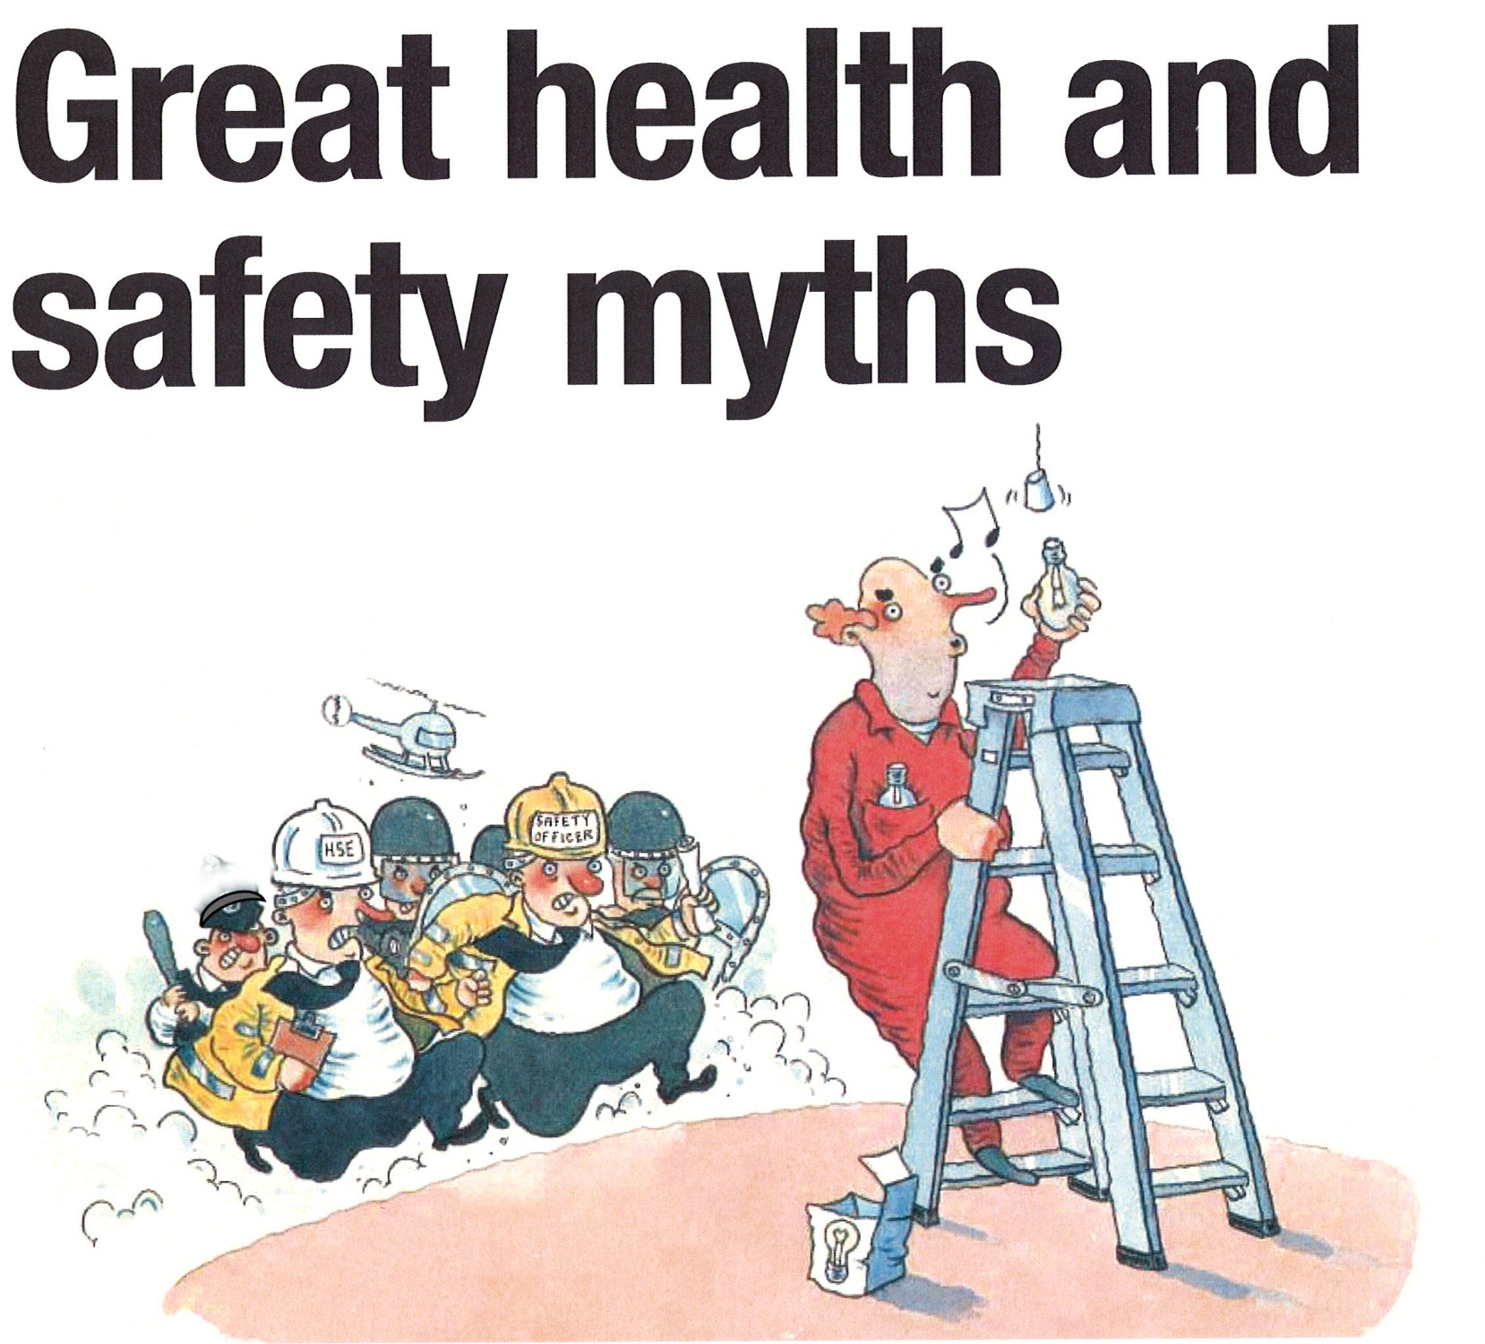


District School Board Ontario North East
Lets use Ladders Safely

Slide 2
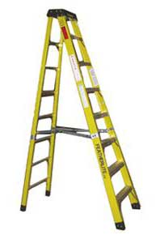
Types of materials
Fibre Glass and aluminum

Slide 3
Avoiding Ladder Accidents
Am I healthy enough to work off a ladder?
Avoid working at heights where possible
Fall Prevention must be used
Is a step ladder the most suitable access equipment compared to other options?
Like what?-
Scaffolding or elevating work platforms!

Slide 4
Is what your doing a Suitable Activity to perform from a ladder?
No work longer than 30 minutes from a ladder
No strenuous or heavy work

Slide 5
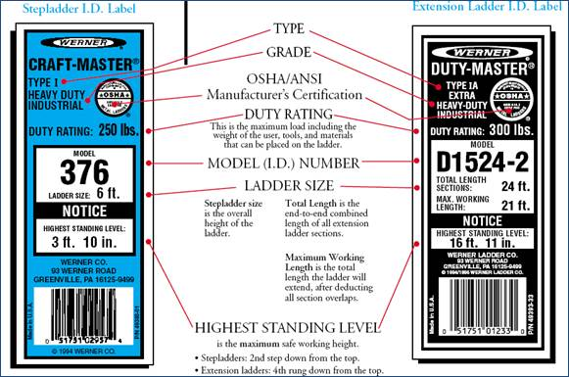
Ladder Selection
Can it support you?

Slide 6
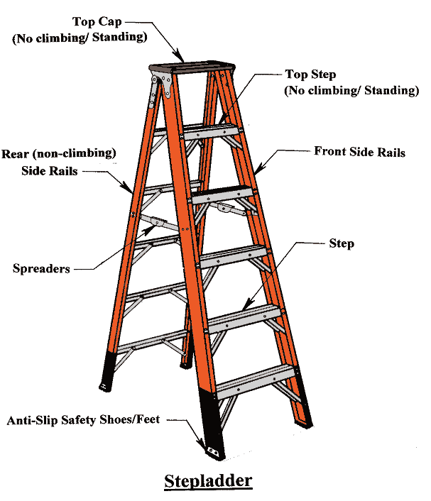
Ladder Inspection
Inspect for defects

Slide 7
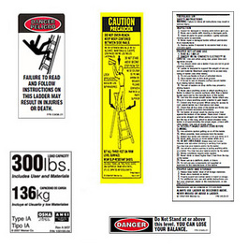
Ladder Safety Information labels

Slide 8
Ladder Set Up
Check for obstructions ,equipment ,around and overhead.
Make sure area is level and firm
Lock, block or guard doorways
Barricades are required in high traffic areas
Position for work
Fully open and lock laterals on legs
Push test before climbing to check stability

Slide 9
Climbing a Ladder
Always face the ladder
Maintain 3 point contact
Maintain body within the side rails
Don’t overreach to access work
Don’t side load ladder by task performed
Have ladder face work
Hoist ,pass or sling in a bag tools or materials

Slide 10
Staying on the ladder
Never work past the top 2 steps
Never stand on the top of a step ladder, it is a hinge not a step!
Wear protective slip resistant shoes ,make sure they are clean ,not muddy or slippery
Maintain balance, do not get disoriented by looking overhead or up

Slide 11
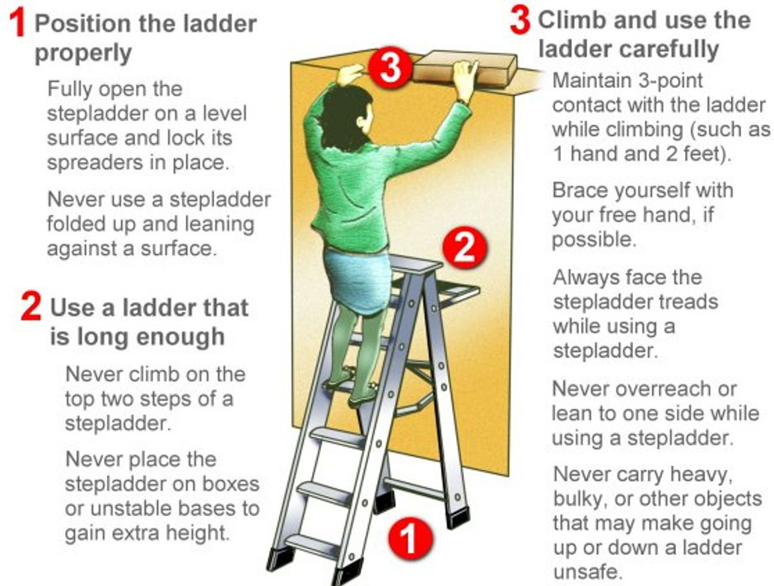
Review

Slide 12
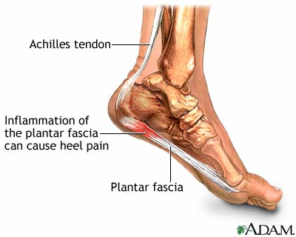
Ladder Related MSD Injuries
Foot injury can result during use by
Improper footwear
Overweight, or pregnant
Extended periods of use

